Slide 1
Platforms
BFL-IoT: A Blockchain-Enabled Federated Learning Model for Secure and
Efficient Data Transmission in IoT Networks
GROUP MEMBER:
PRAKADEESH B S - 225003104
GUIDE DETAILS :
Dr. N.RAJESH KUMAR
Assistant Professor
Department of Computer Science and Engineering
DATE : 15-05-2025

Slide 2
BASE PAPER DETAILS
A blockchain-orchestrated deep learning approach for secure data transmission in
IoT-enabled healthcare system
AUTHORS :
1.Prabhat Kumar
2.Randir Kumar
3.Govind P. Gupta
Year: 2023

Slide 3
ABSTRACT
The growth of Internet of Things (IoT) networks across industries, it will become increasingly important to ensure that the information transmitted is secure due to the rise in cyber threats and the sensitivity of the information. This project will present a Blockchain-enabled Federated Learning model (BFL-IoT) for secure and efficient data transmission in generic IoT networks. By leveraging the decentralized and tamper-resistant architecture of blockchain along with the privacy-preserving training of federated learning, the proposed model will guarantee secure communication between IoT devices while maintaining data privacy. The BFL-IoT model will decentralize the storage of information, with only encrypted model parameters being shared for collaborative training, thus reducing the risks of unauthorized access. The model will also be capable of detecting and countering different types of cyberattacks in IoT networks with high accuracy, distinguishing between normal and adversarial activities. The model will be tested through experimental evaluations and is expected to outperform traditional approaches in terms of security, scalability, and performance for securing and authenticating IoT data transactions across various applications.

Slide 4
PROBLEM STATEMENT
The rapid growth of digital data transmission, confidential information is vulnerable to cyber threats, unauthorized access and data violations. Traditional security approaches face challenges such as centralized risks, scalability problems and high computational costs. Ensuring the privacy and integrity of the data while allowing efficient automatic learning in distributed data is an important challenge. This project aims to develop a safe and decentralized data transmission model using blockchain for the integrity of data and federated learning for privacy prevention. The objective is to improve security, reduce cyber threats and guarantee data transmission without problems and reliable in modern digital environments.

Slide 5
LITERATURE SURVEY
S.NO | TITLE | AUTHOR | ACCEPTED DATE | MODEL | MERITS | DEMERITS
1 | Attack and Anomaly Detection in IoT Sensors Using Machine Learning Approaches | Mahmudul Hasan, Md. Milon Islam, Md Ishrak Islam Zarif, M.M.A. Hashem | 11 May 2019 | Logistic Regression, SVM, Decision Tree, Random Forest, ANN | Comprehensive comparison across multiple machine learning models High performance in detecting both known and unknown threats | Signature-based methods fail to detect zero-day attacks High resource consumption for training complex models like ANN
2 | Attack Detection in IoT Using Machine Learning | Maryam Anwer, Muhammad Umer Farooq, Shariq Mahmood Khan, Waseemullah | 2021 | Support Vector Machine, GBDT, Random Forest (RF) | Uses widely accepted NSL-KDD dataset for benchmarking Covers multiple supervised learning algorithms for comparison | Lack of suitable data sets with proper masked faces and facial recognition Presence of masks created noise in data

Slide 6
S.NO | TITLE | AUTHOR | ACCEPTED DATE | MODEL | MERITS | DEMERITS
3 | Intrusion Detection Models for IoT Networks via Deep Learning Approaches | Bhukya Madhu, M. Venu Gopala Chari, Ramdas Vankdothu, Arun Kumar Silivery, Veerender Aerranagula | 9 December 2022 | Device-Based Intrusion Detection System (DIDS), Deep Learning | Handles large volumes of IoT traffic with reduced overhead Efficiently detects unknown attacks in real-time IoT networks | Computational overhead in large-scale IoT environments Lacks robustness in handling certain advanced attack types
4 | Identification of Cyber Attacks Using Machine Learning in Smart IoT Networks | C. Malathi, I. Naga Padmaja | 2023 | Machine Learning (various algorithms), Bot-IoT metadata | High success in detecting DoS attacks using Bot-IoT dataset Utilizes multiple machine learning algorithms for comparison | High computational resource requirement for training Difficult to implement in real-time IoT systems

Slide 7
S.NO | TITLE | AUTHOR | ACCEPTED DATE | MODEL | MERITS | DEMERITS
5 | A Blockchain-Based Intrusion Detection/Prevention Systems in IoT Network: A Systematic Review | Khawla Shalabi, Qasem Abu Al-Haija, Mustafa Al-Fayoumi | 2024 | Blockchain-based IDS/IPS | Enhances privacy and security using blockchain mechanisms Provides insight into blockchain's role in preventing future attacks | Blockchain validation can introduce latency in detection Difficult to implement on resource-limited IoT devices
6 | Implementation of Attack Detection and Mitigation for Securing Cloud-Based IoT Network | Archana D. Wankhade, Kishor P. Wagh | 5 May 2024 | Decision Tree, K-Nearest Neighbors (KNN), Logistic Regression | Robust performance across different machine learning algorithms Effective use of lightweight cryptography for IoT devices | Limited scalability due to computational complexity Lightweight cryptography struggles with high-resource IoT devices

Slide 8
S.NO | TITLE | AUTHOR | ACCEPTED DATE | MODEL | MERITS | DEMERITS
7 | Intrusion Detection Using Synaptic Intelligent Convolutional Neural Networks for Dynamic IoT Environments | Hui Chen, Zhendong Wang, Shuxin Yang, Xiao Luo, Daojing He, Sammy Chan | 3 October 2024 | Synaptic Intelligent Convolutional Neural Networks (SICNN) | High detection accuracy in dynamic, real-time IoT environments Optimized for resource-constrained IoT devices | High resource consumption limits deployment on low-power devices Requires continuous data retraining due to IoT network changes
8 | A Novel Stable Feature Selection Algorithm for Machine Learning-Based Intrusion Detection System | Sowmya T, Dr. Mary Anita E A | 2025 | IV-RFE (Iterative Variance and Recursive Feature Elimination), Machine Learning | Improved accuracy and stability in feature selection for IDS Reduces computational complexity in handling large datasets | Complexity in managing large datasets with multiple features Lacks scalability for larger networks

Slide 9
OBJECTIVE
To implement secure data transmission with blockchain and federated learning over IoT network
To detect cyber attacks and prevent unauthorized access
To evaluate the peformance of proposed model for ensuring scalability and efficiency

Slide 10
WORK PLAN
Data collection and Preprocessing
Blockchain Implementation
Federated Learning Model
Integration of Blockchain and Federated Learning
Testing and Evaluation

Slide 11
EXISTING SYSTEM WITH LIMITATIONS
The current methods for securing data transmission have several challenges. Centralized systems are prone to failure and can be attacked easily. Encryption helps keep data private but doesn't stop unauthorized access or data changes
Machine learning models need a lot of labeled data and usually store it centrally, which can lead to privacy risks
Deep learning methods require sharing data for training, which also raises privacy concerns
Existing security systems improves data integrity, but it is slow, uses a lot of computing power, and struggles to scale. These issues make existing solutions inefficient for secure data transmission

Slide 12
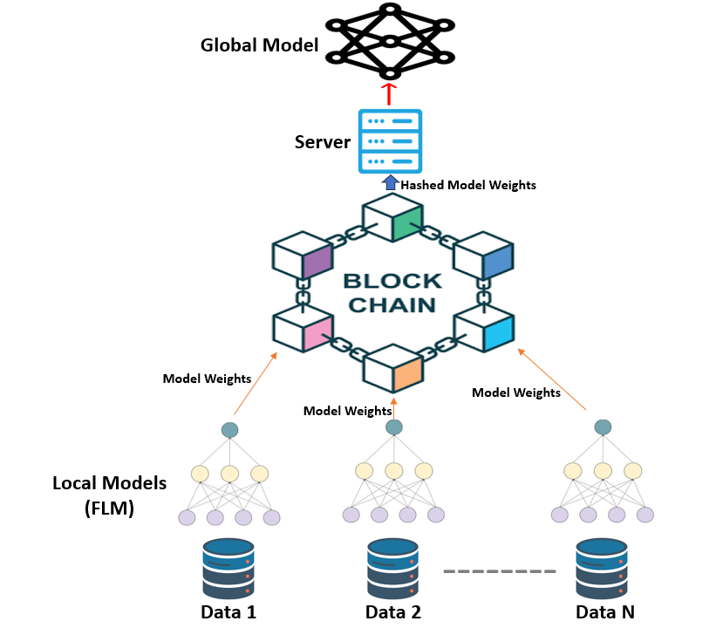
PROPOSED SYSTEM ARCHITECTURE

Slide 13
PROPOSED SYSTEM
The proposed system integrates Blockchain with Federated Learning to enhance secure data transmission and privacy
Instead of sharing raw data, only model updates (gradients/weights) are exchanged, ensuring better security and efficiency
Blockchain maintains a tamper-proof record of model updates, preventing malicious contributions and ensuring trust
Advantages:
Decentralized & Secure – Blockchain prevents unauthorized access and tampering
Privacy-Preserving – Federated Learning ensures data remains local
Efficient & Scalable – Reduces computation and communication overhead

Slide 14
Dataset Preprocessing
Read all 23 CSV files and stored them in a list for processing.
Ensured all datasets have consistent column names.
Filled or dropped missing values based on importance.
Merged columns to maintain uniformity.
Converted columns to appropriate data types (numeric, categorical, etc.).

Slide 15
Dataset Preprocessing
Used SMOT oversampling technique for maintaining balance in the dataset
Dropped duplicate rows to avoid redundant data.
Apply MinMaxScaler for uniform feature scaling and consistency.
Used one-hot encoding and label encoding as required.
Removed irrelevant or highly correlated features.
Store the cleaned datasets as clients.

Slide 16
Blockchain Implementation
Blockchain is implemented to secure Federated Learning (FL) model updates by ensuring integrity, transparency, and decentralization.
1.Setting up the Blockchain Ethereum Network
I used the Ethereum Blockchain (Sepolia Testnet) to store model update hashes.
Transactions on Ethereum are recorded permanently, ensuring security.
Instead of using real money, I used test tokens from Sepolia Testnet.

Slide 17
Blockchain Implementation
2. Writing a Smart Contract
It is a piece of code that runs on Ethereum and ensures data integrity.
It is used to store and retrieve model update hashes.
The smart contract is written in Solidity and deployed on Ethereum.
Every time a model is updated, the hash is stored using this contract.
3. Storing Model Updates in IPFS
Since Blockchain storage is expensive, I used IPFS (InterPlanetary File System).
The actual model update is uploaded to IPFS, which generates a unique hash.
Only this hash is stored on Ethereum, keeping storage cost low while ensuring security.

Slide 18
Blockchain Implementation
4. Interacting with Blockchain Using Web3 & Flask
To make it easier, I created a Flask API to interact with the Blockchain.
This API does two main things:
  Send an update to Blockchain (store the IPFS hash).
  2. Retrieve stored updates from Blockchain.
I used Web3.py (a Python library) to communicate with Ethereum.
5.Verifying Transactions on Etherscan
Every time a model update is stored, a transaction is created on Ethereum.
This transaction can be checked on Etherscan (a blockchain explorer).
The transaction hash will be entered on sepholia website to verify it.

Slide 19
Models Explanation
Deep Neural Network:
DNN is a deep learning model with multiple layers of neurons.
Each layer is fully connected and passes information forward.
It learns complex non-linear relationships in the input features.
Working Mechanism:
Each neuron calculates: activation(weight * input + bias)ReLU activation keeps positive values, helping in learning.
Dropout layers prevent overfitting by randomly disabling neurons during training.
The final sigmoid outputs a value between 0 and 1 interpreted as normal (0) or attack (1).

Slide 20
Models Explanation
Convolutional Neural Network:
CNN is ideal for pattern recognition in sequences.
Automatically extracts important local patterns.
Commonly used in time-series and network traffic analysis.
Working Mechanism:
Conv layers slide filters over features to detect local behaviours (like sudden spikes or traffic patterns).
Pooling reduces dimensionality and retains key informations.
Flatten converts 2D data to 1D.
Dense + sigmoid layers make final prediction.

Slide 21
Models Explanation
Logistic Regression:
Traditional machine learning algorithm.
Used as a baseline model in binary classification tasks.
Interpretable and quick to train.
Working Mechanism:
Calculates a weighted sum of input features.
Applies sigmoid function to output probability.
If output > 0.5 → attack, Else → normal.

Slide 22
Accuracy comparison for Local and Global Model
Model Name | Local Model 1 Accuracy | Local Model 2 Accuracy | Local Model 3 Accuracy | Local Model 4 Accuracy | Average Local Model Accuracy | Global Model Accuracy
DNN | 97.81 | 98.19 | 97.99 | 97.03 | 97.75 | 95.04
CNN | 97.43 | 97.18 | 97.06 | 95.95 | 96.90 | 93.97
LR | 88.19 | 87.88 | 88.24 | 88.02 | 88.08 | 87.71
Given its superior performance over the other two models, the Deep Neural Network(DNN) was chosen for Blockchain
Integration to enhance security and reliability

Slide 23
Model Accuracy Comparison

Slide 24
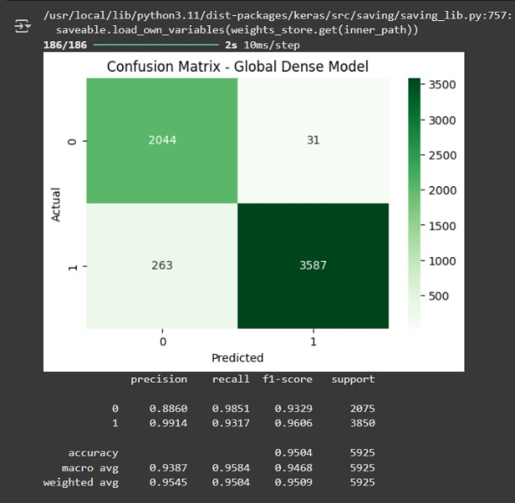
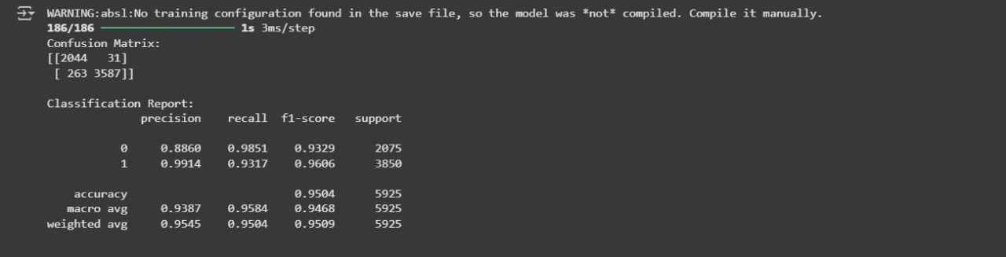
Results
DNN Accuracy for Global Model
Blockchain Integrated DNN Accuracy for Global Model

Slide 25
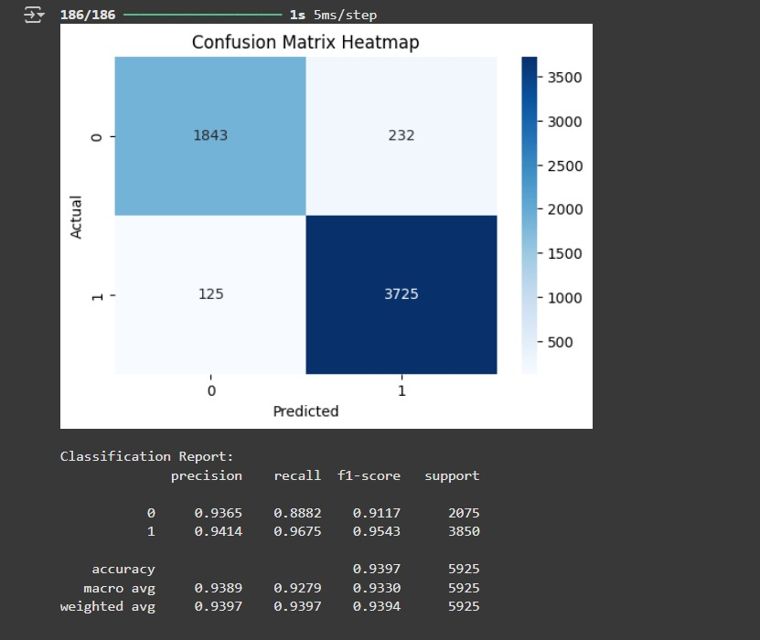
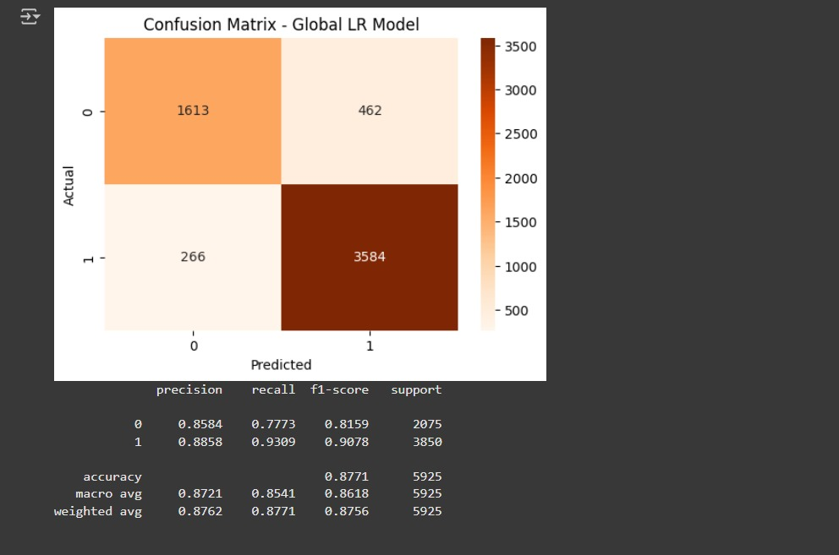
Results
CNN Accuracy for Global Model
LR Accuracy for Global Model

Slide 26
CONCLUSION
In this project, I implemented a secure and efficient attack detection system using Federated Learning with Deep Neural Networks, CNN, and Logistic Regression. I trained multiple local models on separate datasets and aggregated them to form a global model. I integrated Blockchain to store and retrieve model updates securely using IPFS and a smart contract. Additionally, I built a web-based UI for uploading CSV files, predicting attacks, and securely transmitting only the normal data with features like encryption and user authentication.

Slide 27
REFERENCES
[1] Archana D. Wankhade, Kishor P. Wagh - Implementation of Attack Detection and Mitigation for Securing Cloud-Based IoT Network Journal of Theoretical and Applied Information Technology, Vol. 102, No. 9, 2024
[2] Maryam Anwer, Muhammad Umer Farooq, Shariq Mahmood Khan, Waseemullah - Attack Detection in IoT Using Machine Learning Engineering, Technology & Applied Science Research, Vol. 11, No. 3, 2021
[3] Zhiqiang Feng - IoT Data Sharing Technology Based on Blockchain and Federated Learning Algorithms Intelligent Systems with Applications, Vol. 22, 2024
[4] Hui Chen, Zhendong Wang, Shuxin Yang, Xiao Luo, Daojing He, Sammy Chan - Intrusion Detection Using Synaptic Intelligent Convolutional Neural Networks for Dynamic IoT Environments Alexandria Engineering Journal, Vol. 111, 2025
[5] Bhukya Madhu, M. Venu Gopala Chari, Ramdas Vankdothu, Arun Kumar Silivery, Veerender Aerranagula - Intrusion Detection Models for IoT Networks via Deep Learning Approaches Measurement: Sensors, Vol. 25, 2023

Slide 28
[6] Mahmudul Hasan, Md. Milon Islam, Md Ishrak Islam Zarif, M.M.A. Hashem - Attack and Anomaly Detection in IoT Sensors Using Machine Learning Approaches Internet of Things, Vol. 7, 2019
[7] Khawla Shalabi, Qasem Abu Al-Haija, Mustafa Al-Fayoumi - A Blockchain-Based Intrusion Detection/Prevention Systems in IoT Network: A Systematic Review Procedia Computer Science, Vol. 236, 2024
[8] Sowmya T, Dr. Mary Anita E A - A Novel Stable Feature Selection Algorithm for Machine Learning-Based Intrusion Detection System Procedia Computer Science, Vol. 252, 2025
[9] C. Malathi, I. Naga Padmaja - Identification of Cyber Attacks Using Machine Learning in Smart IoT Networks Materials Today: Proceedings, Vol. 80, 2023

Slide 29
THANK YOU

